Slide 1

Integrating information towards Digital ATM
Weather Information Exchange Model
- WXXM -
Presented By:
- Alfred Moosakhanian, FAA
- Dennis Hart, EUROCONTROL
Date: August 27, 2013

Slide 2
Overview
WXXM and IWXXM evolution
  Background
  Current Development Status
  Proposed Timeline
The Digital ATM Context
  Developments in ICAO
  ‘Observations’

Slide 3
WXXM Evolution
WMO and ICAO are jointly moving forward to enable data centric weather exchange
WXXM is key to data centric concepts and applications & NextGen/SESAR support
  The World Meteorological Organization (WMO) establishes the basis for global MET/Wx information exchange
  ICAO establishes the basis for Meteorological Service for International Air Navigation (ICAO Annex 3)
  Open Geospatial Consortium (OGC) provides the forum for establishing open standards for exchanges of geospatial referenced information

Slide 4


ICAO and WMO Packages
ICAO Responsibility
Aviation requirements and regulation
ICAO Meteorological Information Exchange Model (IWXXM)
METAR, SPECI, TAF, and SIGMET representations
Simple Aeronautical Features (SAF)
Simplified features from the aeronautical domain
WMO Responsibility
Weather regulation and technical implementation
Meteorological Community Exchange Model (METCE)
WMO logical data model, specifically Observations and Measurements (O&M) specializations
Observable Property Model (OPM)
Qualifications and constraints on observed properties

Slide 5




Standards Relationship
ICAO Annex 3 products:
METAR/SPECI,
TAF, SIGMET
IWXXM
Next-generation aviation weather products:
Contours, aircraft reports, gust front, motion vector, etc.
US Specializations of ICAO Annex 3 products:
US METAR/SPECI,
US TAF, US SIGMET
IWXXM-US
WXXM
Next-generation products may feed into IWXXM over time

Slide 6
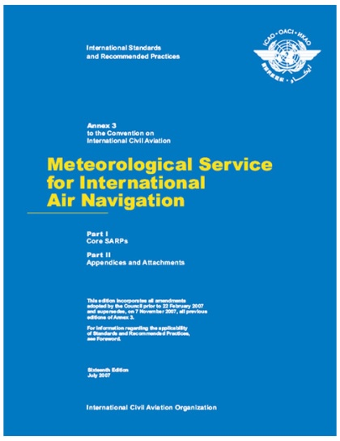
ICAO Annex 3
under bilateral agreements between States in a position to do so, states may exchange METAR, SPECI, TAF and SIGMET in XML/GML form in addition to traditional forms
(November 2013 - Amendment 76)

Slide 7
Data Models (today)
Data Model
Component Agility
Standards Governance Body
High
(months)
EU-Specific Components
US-Specific Components
Other Stakeholder Components
Individual Organizations
Other Aviation-Specific Weather Components (WXXM)
EUROCONTROL (SJU), FAA,
and others
Operational ICAO Defined Aviation-Specific Weather Components (ICAO IWXXM)
International Civil
Aviation Organization (ICAO)
General Purpose Weather Components (WMO METCE)
World Meteorological
Organization (WMO)
GML
ISO 19136
Observations and Measurements
ISO 19156
ISO / OGC
ISO 19103, 19107, 19108, 19115, 19123, …
XML
UML
W3C / OMG
Low
(years)

Slide 8
IWXXM and WXXM
IWXXM
Strict and complete representation of ICAO Annex 3 products – METAR, SPECI, TAF, SIGMET (regulated products)
WXXM
Next-generation aviation and weather data representations
Business rules strongly enforced
Managed by ICAO and WMO
Updated on roughly the same time scale as ICAO Annex 3 (currently 3 years)
General purpose, reusable data types (aerial report, profile, trajectory, area forecast, point forecast, etc.)
Open/extensible content policy
Many products and data types beyond ICAO Annex 3
Managed by Eurocontrol, FAA, and other partners
Updated roughly every year

Slide 9
WXXM 2 Changes
Incorporate ICAO and WMO Models
  Observations and Measurements 2/ISO 19156
  Measures and Quantities
  Registry and semantics support
  Remove the “wx” namespace
  Weakly-typed products
    Emphasis on
(Possible) XML Schema 1.1
  Open content model
  Rules-based validation
Will NOT include:
GML 3.3

Slide 10
Timeline (proposed)
METCE 1.0 RC 1/IWXXM 1.0 RC 1
Initial version
METCE 1.0 RC2/IWXXM 1.0 RC2
METCE 1.0/IWXXM 1.0
Changes based on feedback
July 2013
October 2012
February 2013
Official release
WXXM 2.0
Official release
December 2013

Slide 11
Overview
The Digital ATM Context
  Developments in ICAO
  ‘Observations’

Slide 12

The Digital ATM Context
Data (exchange) models should serve a purpose ☺
Should enable Digital ATM
Shall enable knowledge based decision making in ATM
  System-system and human in the loop interactions

Slide 13
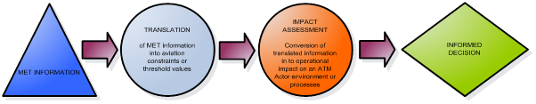
MET–ATM Information Integration Functions
(under discussion ICAO)
Provision of information on the past, current and future state of the atmosphere expressed in generic terms and produced and used without considering the user context.
Process of deriving information on weather related constraints for an ATM actor based on the provided MET information and the provision thereof. MET information is combined with known operational information such as safety regulation, aircraft restrictions, operating thresholds, historical demand information or historical pilot behaviour information to derive an ATM actor specific constraint or threshold value.
Process of deriving ATM impact information for a specific ATM actor environment based on the provided MET Translation information and the provision thereof. In this process, the MET Translation information is combined with actual and planned operational information from the perspective of the ATM actor.
Process of deriving a strategic or tactical solution in respect of the assessed impact of weather on an ATM actor process/environment

Slide 14
MET–ATM Information Integration Functions
(under discussion ICAO)
Performance requirements will determine the elements thus level of integration required
NextGen / SESAR notions:
‘4D WxCube’
‘Common Support Service’

Slide 15
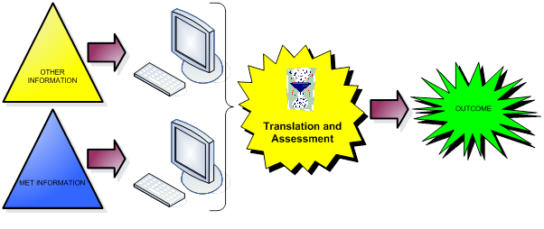
Levels of Integration
0
“Swivel chair integration”
Level of integration to improve

Slide 16
Levels of Integration
I
2
*one example of how ‘other info’ feeds into the chain

Slide 17
Levels of Integration
3

Slide 18
Levels of Integration
What changes btn 2 and 3

Slide 19
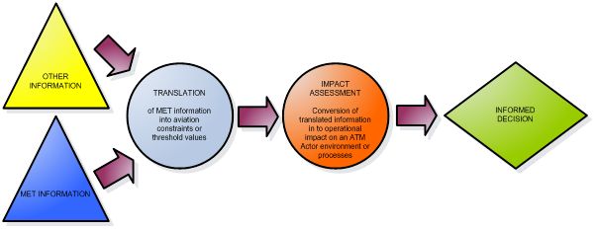
Levels of Integration
4

Slide 20
WXXM/IWXXM and MET-ATM Integration
NextGen / SESAR notions:
‘4D WxCube’
‘Common Support Service’
Sufficient for up to level 2
WXXM/IWXXM

Slide 21
SESAR / NextGen Ambition

Slide 22

‘ ATM Impact assessment engine’

Slide 23
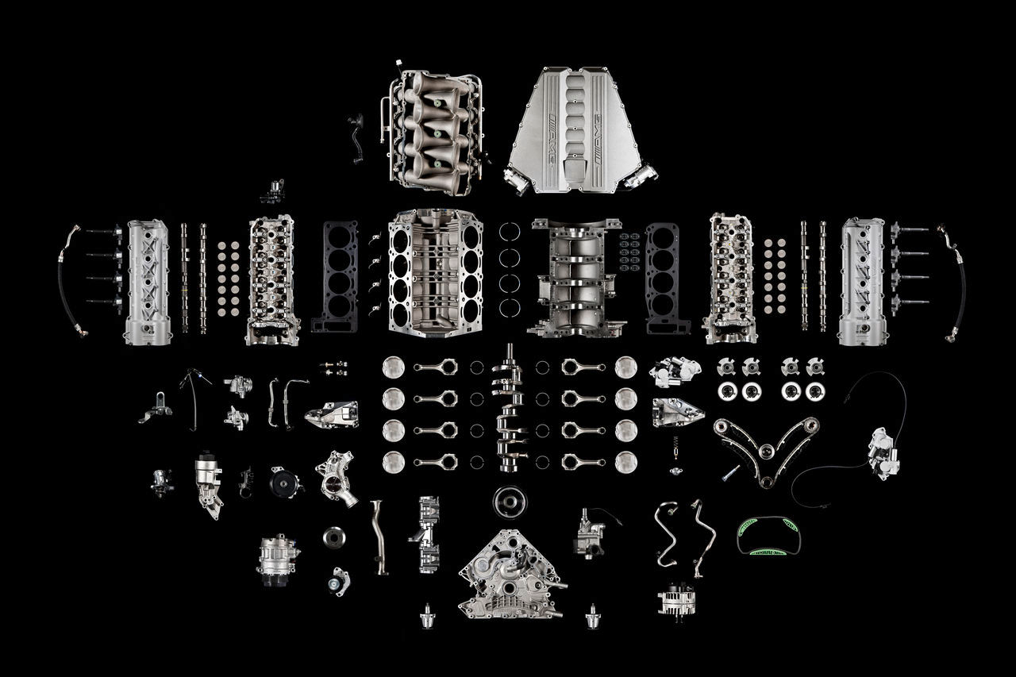
Information Management / Exchange
elements in place….

Slide 24

Can we move towards Digital ATM?

Slide 25
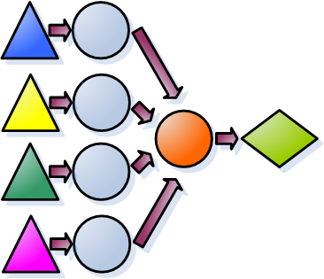
Observations
WXXM/IWXXM
AIXM
FIXM
….

Slide 26
Observations, ctd.
ATM Information and Services Reference Framework
WXXM/IWXXM
AIXM
FIXM
….

Slide 27
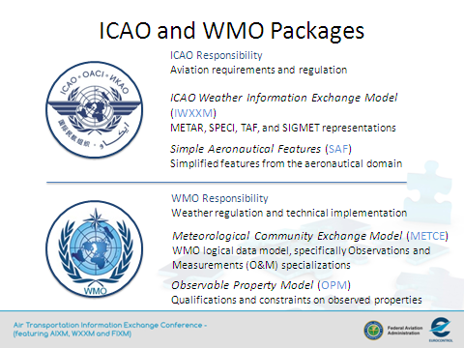
Observations, ctd.

Slide 28
Summary
WXXM and IWXXM evolution
  Recent Developments
  Current Development Status
  Proposed Timeline
The Digital ATM Context
  Developments in ICAO
  ‘Observations’

Slide 29
Questions

Slide 30
More Information
http://www.wxxm.aero
https://wiki.ucar.edu/display/NNEWD/WXXM

