Slide 1
FIXM Briefing
AIXM CCB meeting
EUROCONTROL HQ, Brussels
Hubert LEPORI
EUROCONTROL
07-June-2017

Slide 2
Previous briefings
What is FIXM?
FIXM History
FIXM Change Management
Technical talking points
Dec 2016
FIXM 4.1.0 deprecations
FIXM 4.1.0 references to aeronautical info
FIXM 4.1.0 ICAO AIRM coordination
FIXM 4.1.0 Extension mechanism
Dec 2017

Slide 3
Today’s briefing
FIXM Documentation Package
Next FIXM developments (FIXM 4.2.0)
Some FIXM questions / unknowns
FIXM 4.1.0 is released!
Misconception about FIXM
Today

Slide 4
FIXM 4.1.0
15-Dec-2017
https://www.fixm.aero/fixm_410.pl

Slide 5
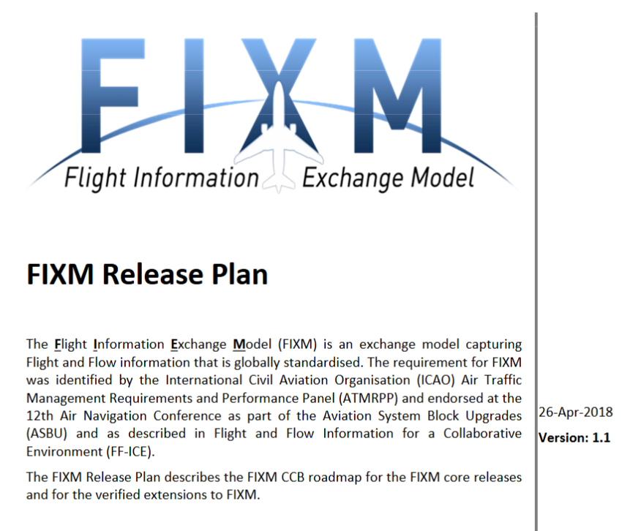
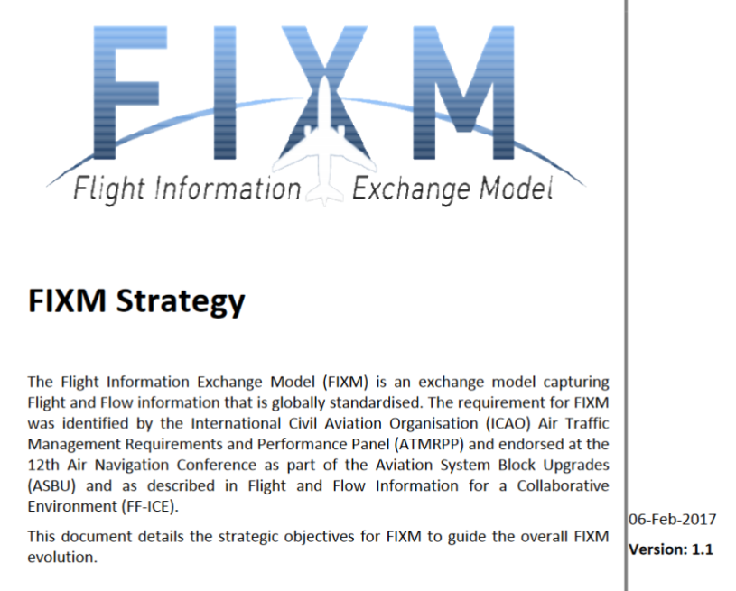

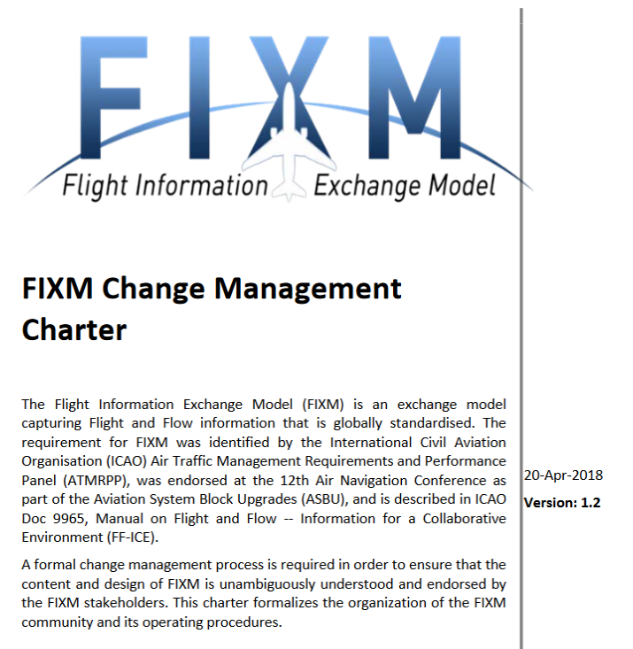
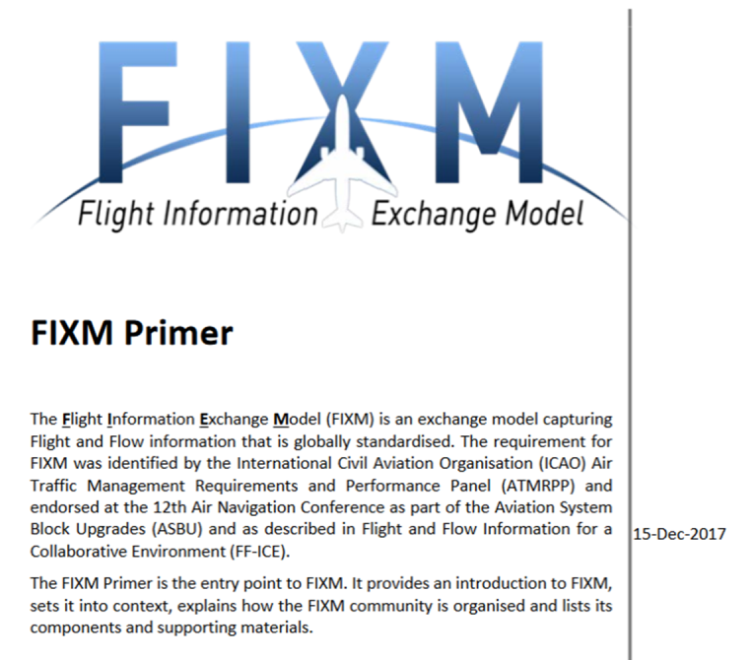

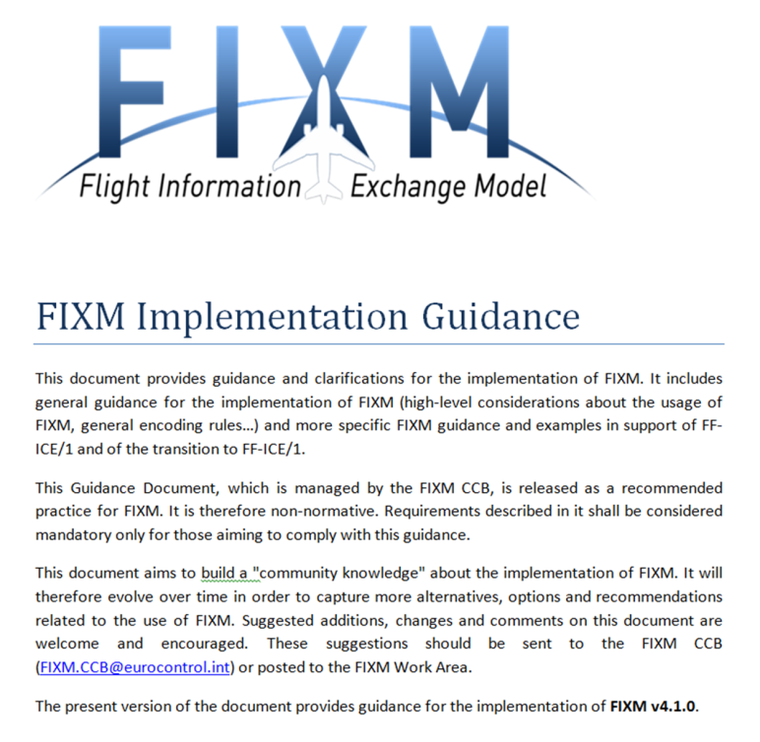

Slide 6

Content not tied to a FIXM version
Developed & endorsed by FIXM CCB
Reviewed by ICAO ATMRPP

Slide 7
Strategic requirements driving the FIXM project
FIXM components
FIXM in the SWIM big picture
…
https://www.fixm.aero/documents/FIXM%20Strategy.pdf

Slide 8
Organisation of the FIXM Community
Operating procedures of the FIXM Change Control Board
Membership rules
Equivalent to & inspired by the AIXM charter
https://www.fixm.aero/documents/FIXM%20Change%20Management%20Charter.pdf

Slide 9
ICAO FF-ICE & SWIM milestones (quotes)
Planned released dates & objectives for next FIXM Core versions
Planned released dates & objectives for FIXM extensions (developed by CCB)
FIXM version policy
(the one agreed with AIXM CCB)
https://www.fixm.aero/documents/FIXM%20Release%20Plan%20v1.1.pdf

Slide 10
Content tied to a FIXM version
Developed & endorsed by FIXM CCB

Slide 11
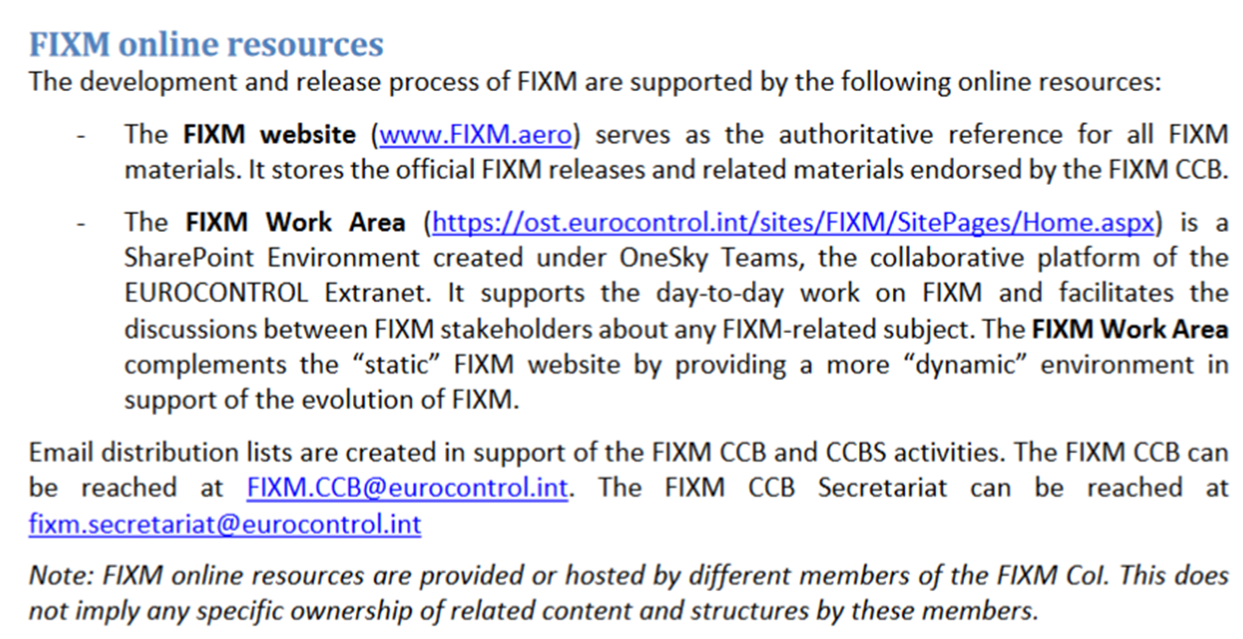
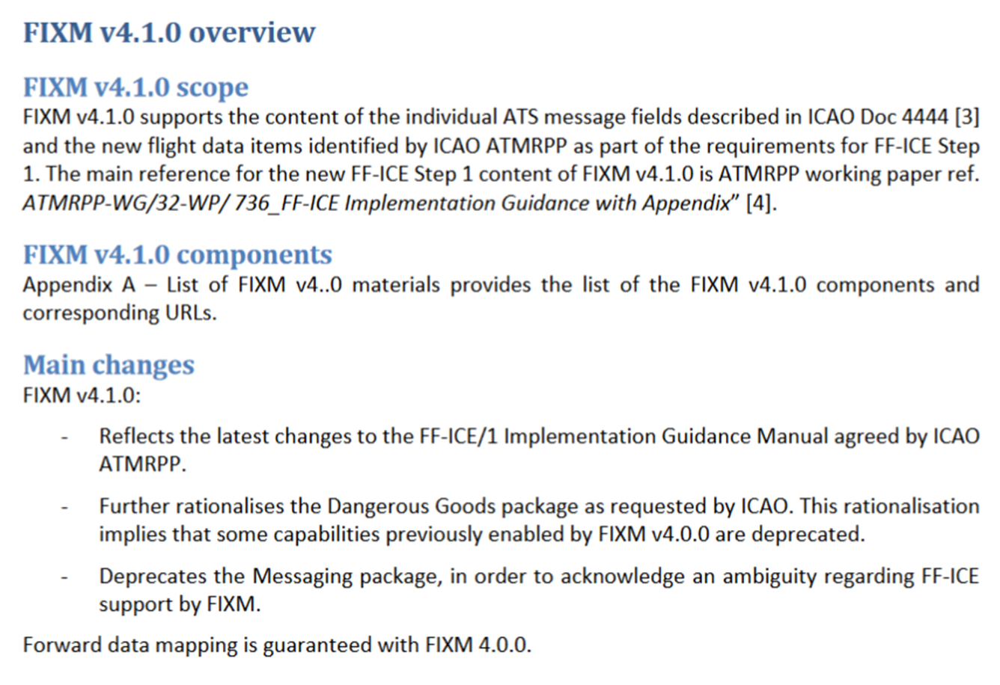
Entry point to a given FIXM version
For FIXM 4.1.0:
https://www.fixm.aero/releases/FIXM-4.1.0/FIXM_Core_v4_1_0_Primer.pdf

Slide 12
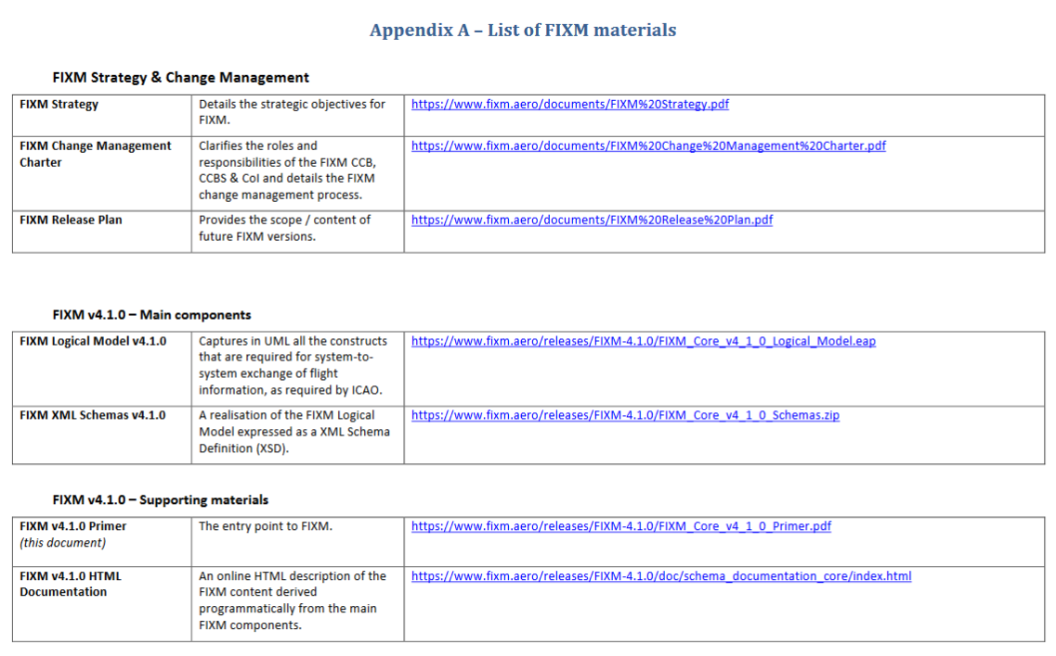

Slide 13
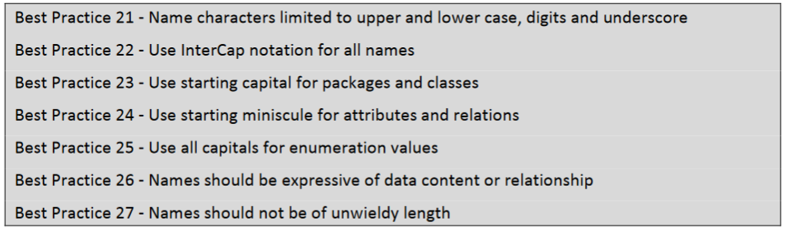
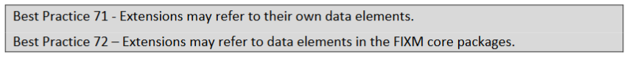
Rulebook for designing FIXM Core
Rulebook for designing FIXM Extensions
For FIXM 4.1.0:
https://www.fixm.aero/releases/FIXM-4.1.0/FIXM_Core_v4_1_0_Modelling_Best_Practices.pdf

Slide 14
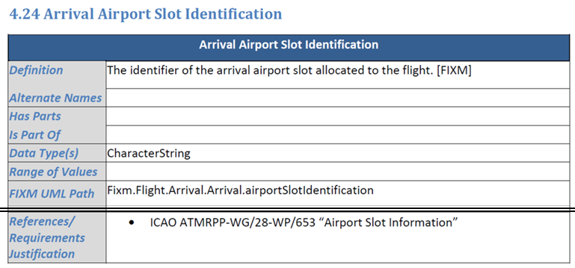
Catalogue of flight data elements supported by the FIXM version
Traceability between the FIXM model elements and the requirements from ICAO
For FIXM 4.1.0:
https://www.fixm.aero/releases/FIXM-4.1.0/FIXM_Core_v4_1_0_Operational_Data_Description.pdf

Slide 15




General guidance for the implementation of FIXM
Guidance for the implementation of FIXM in support of FF-ICE/1
Requirements on FIXM core usage
Requirements on FIXM extension usage
Validation approach for FIXM
General FIXM encoding rules
  Geographical position
  References to aeronautical info
  …
Role of FIXM in support of FF-ICE
Examples of FF-ICE/1 Services Implementations (Planning, Filing)
Guidance for the implementation of FIXM to encode existing FPL, as a precursor towards FF-ICE/1
FIXM XML Samples

Slide 16
Let’s open the document and have a look at…
2.2.2. What is considered a valid FIXM core usage?
2.4.1. Use of FIXM schema profiles
2.5.3. References to published aeronautical information
3.3. Building examples of FF-ICE/1 Realization through FIXM-Based Services
3.5. Filing Service – Example of realisation
4.3. ATS Message Content to FIXM Logical Model Map
5.3. FIXM Samples of ATS Messages for a Full Flight Life-Cycle

Slide 17
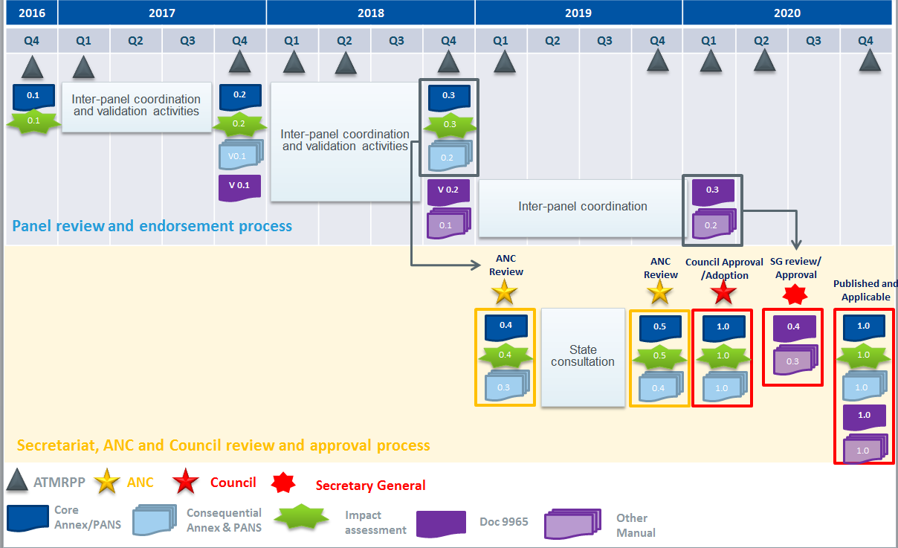

Next FIXM version
FIXM 4.2.0
30-Jun-2019

Slide 18
Next FIXM version – FIXM 4.2.0
May version of the FF-ICE/1 Implementation guidance
Q4 2018 version of revised (draft) ICAO Doc 9965
2018
ATMRPP WG/33
ATMRPP/4
2019
J
F
M
A
M
J
J
A
S
O
N
D
J
F
M
A
M
J
J
A
S
O
N
D
FIXM Workshop
FIXM Workshop?
FIXM Workshop?
Start of the 4.2.0
development
FIXM 4.2.0
ALPHA
FIXM 4.2.0
BETA
FIXM 4.2.0
RC1
Official FIXM 4.2.0
Final FIXM Implementation guidance
Iteration 1 based on
Iteration 2 based on
Main thread
Analyse ATMRPP’s FF-ICE/1 Implementation guidance and improve FIXM accordingly
Messaging & Absent data
FIXM Implementation guidance
Complementary thread
Testing activities / V&V
Using ALPHA
Using BETA
Using RC1
Correct bugs

Slide 19
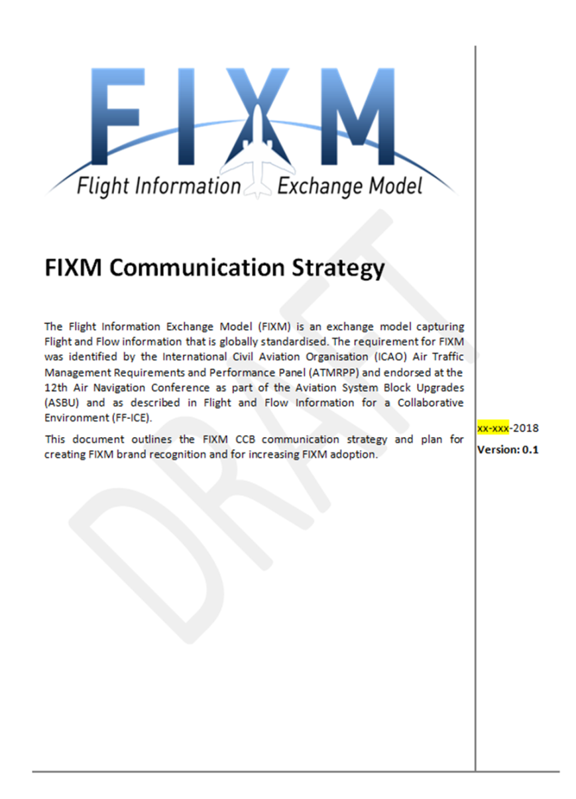
Link to ICAO ATMRPP’s FF-ICE Roll-out and communication strategy
Work underway

Slide 20
FIXM questions / unknowns in relation to FF-ICE
From a user perspective, should the FF-ICE transaction elements be technically harmonized?
  If yes, which elements?
  If yes, how to achieve this? As an FF-ICE Message Model building on FIXM? As a component of FIXM core? As a dedicated FIXM extension?
From a user perspective, what is the impact of not harmonizing (technically) any messaging elements?
ICAO ATMRPP/IMP/CP task force addressing FF-ICE impl. over SWIM

Slide 21
Common misconception:
FIXM does not use GML so FIXM is not interoperable with AIXM
WRONG !
Conceptually
ISO19107
Same reference!
LAST BUT NOT LEAST
Technically
FIXM and AIXM understand and encode geometries in the same way !!!
[FIXM 4.1.0]
<fx:point4D srsName="urn:ogc:def:crs:EPSG::4326">
<fb:pos>56.84 -29.860000000000003</fb:pos>
…
[AIXM 5.1]
<aixm:ElevatedPoint srsName="urn:ogc:def:crs:EPSG::4326" gml:id="pTEMPO">
<gml:pos>56.84 -29.860000000000003</gml:pos>
…
Equivalent structures!
One-to-one mappable!

Slide 22
Contact details
FIXM Community
FIXM Secretariat: fixm.secretariat@eurocontrol.int
FIXM CCB: FIXM.CCB@eurocontrol.int
FIXM Online Resources
www.FIXM.aero
FIXM Work Area (register here)
Cross-XM Coordination
Common -XM work area

Slide 23


