Slide 1
AIXM 5.1 – Interoperability issues
AIXM CCB – Webex 22 January 2018

Slide 2
Agenda
AIP Data Set open interoperability topics
Feature identification properties list

Slide 3
Interoperability scenarios
Reason for scenarios
Some interoperability issues (such as discordant UUID) are likely to have different solutions in different use cases
If this is not really the case, the scenarios could be merged in the end…
Proposed scenarios (in the order of priorities)
AIS publishing data under ICAO SARPS (including provision of data to DAT providers or to another ANSP)
Hub scenario (EAD, other regional implementations)
Including data coordination with other hubs
Data originator(s) to/from ANSP (particular case – procedure designer, airport data originator)
Other possible scenarios (for later)
Data merge between FIXM, AIXM and iWXXM data sets
Large scale SWIM interoperability exercises using multiple non-coordinated data sets (such as in the SESAR or FAA demonstrations)
Use of AIXM data for simulators?
Digital NOTAM (world-wide)
IMP “services”

Slide 4
AIP Data SET Use Case
Technical Interoperability rules
Mature content - available for public comments on the Confluence web site
https://ext.eurocontrol.int/aixm_confluence/display/ACGAIP/Interoperability+rules
Added recently:
Metadata
Format and distribution
Use of nilReason
Allowed feature types
Open comments
See Use of extensions

Slide 5
AIP Data SET Use Case
Technical Interoperability rules
Drafting area in Google Drive – for the participants in this working group
https://drive.google.com/drive/folders/0BxlGN-YBj-q0bnZkSzFoaC1HbVE
Open issues
See document…

Slide 6
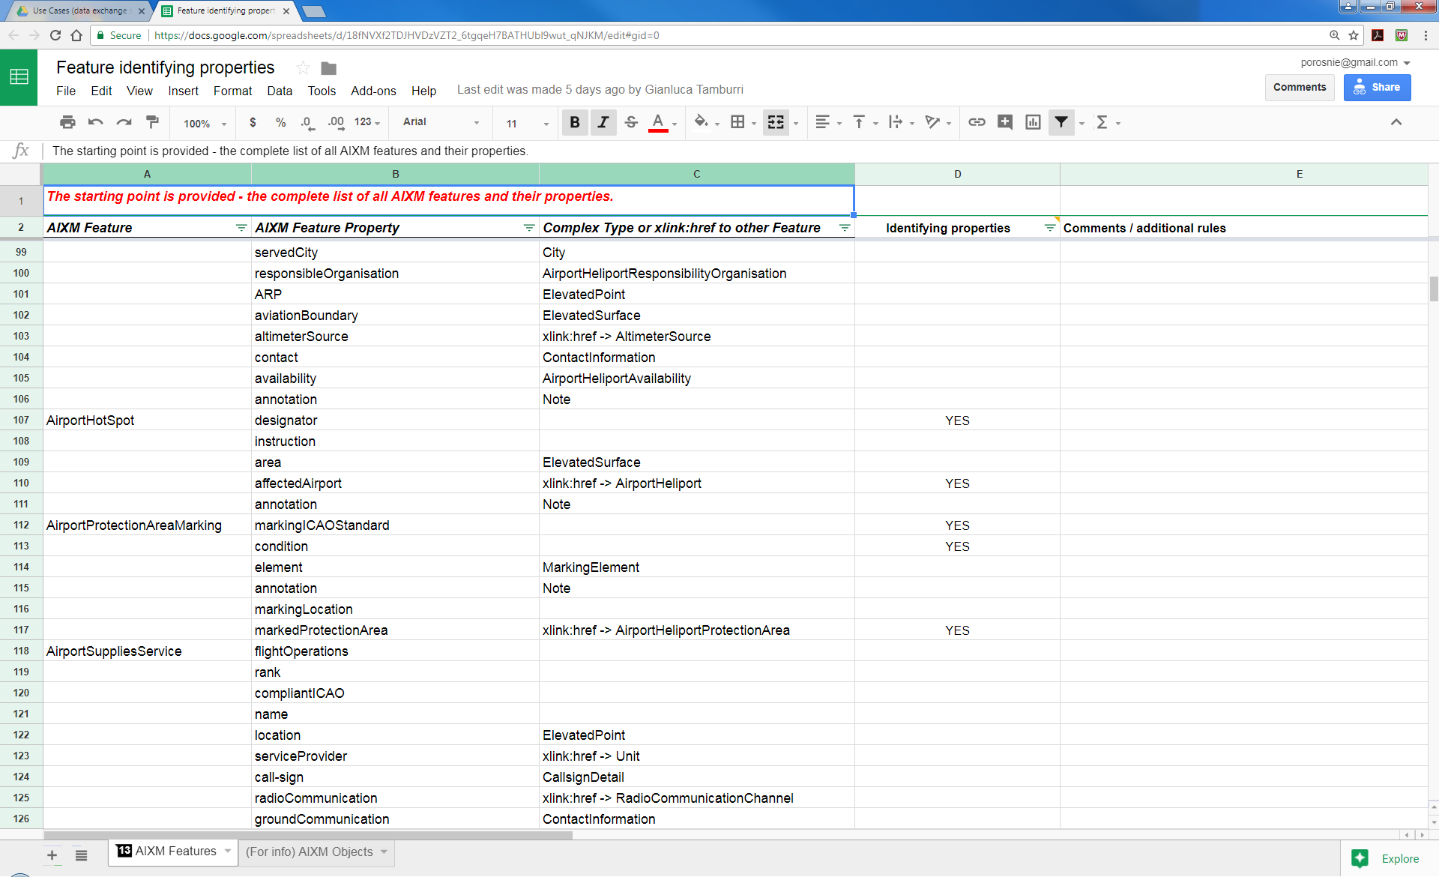
Feature identifying properties
Work in progress – looks almost finalised
Thanks to Manfred Beckmann (Solitec) and Francois Germain (Thales) for drafting, Gianluca Tamburri (IDS) for review. Missed anyone else?
https://drive.google.com/open?id=18fNVXf2TDJHVDzVZT2_6tgqeH7BATHUbl9wut_qNJKM

Slide 7
Feature identification properties
(Still) ToDo
See what other XMs are using when they refer to aeronautical features, for example FIXM, iWXXM
For example, FIXM is using also alternatives (such as ICAO or IATA or name for an aerodrome)
See presentation of FIXM 4.1 from CCB meeting in Brussels: http://aixm.aero/sites/aixm.aero/files/imce/library/ccb_meetings/aixm_ccb_2017_11/fixm_briefing_to_the_aixm_ccb.pptx
Cross-check the list with the proposed mandatory attributes for the AIP data set
Focus on the features that are part of the AIP data set, publish a partial list that concerns only those features, in support of the AIP data set coding guidelines.
Identify potential duplicates by “natural key” (data verification rules with ‘warning’ message
Use in xlink:title

Slide 8
Global issues list
No new entries
https://drive.google.com/open?id=1kLzaYXxtANNHQFpv1Y4HZM1g4S44IDnBSwgF188oS-g
Needs a clean-up…

Slide 9
Next meeting
Next Webex
THU 12 April
14:30 – 16:30 Brussels time
Work items topics expected to progress in the meantime
AIP Data Set open interoperability topics
Feature identification properties list - actions

