Slide 1
AIXM Message Granularity
Presented By: Kevin Lew, CNA
Date: August 29, 2013

Slide 2
Message Granularity
What is the best level of AIXM message granularity for services dealing with only a subset of features?

Slide 3
Message Granularity
AIXM basic message
Using the Event extension to identify features within the message
Service specific message types
A message containing Airspace, Route, and Aerial Refueling features.
Feature specific message types
Provide separate Airspace, Route, and Aerial Refueling messages

Slide 4
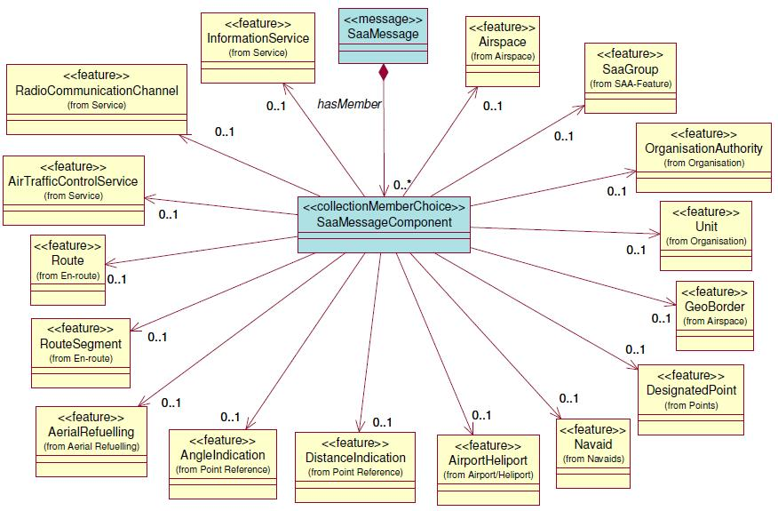
One Message for Airspace, Route, and Aerial Refueling

Slide 5
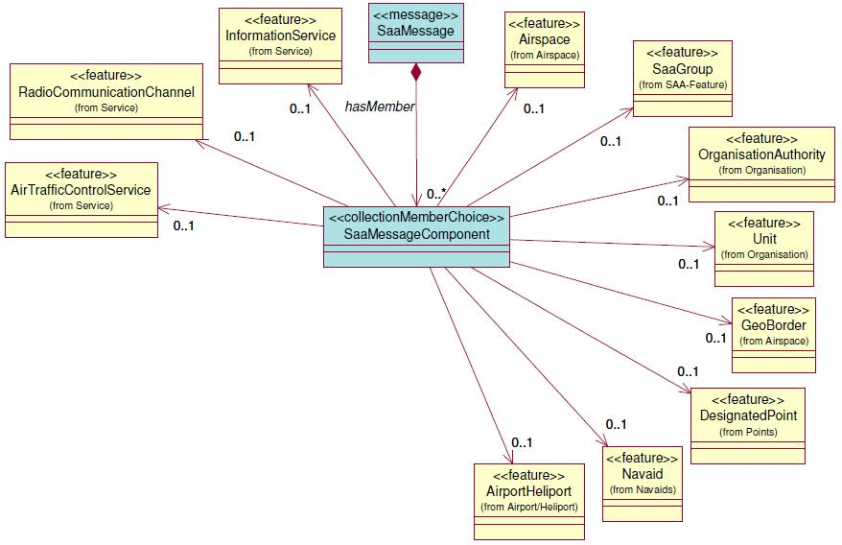
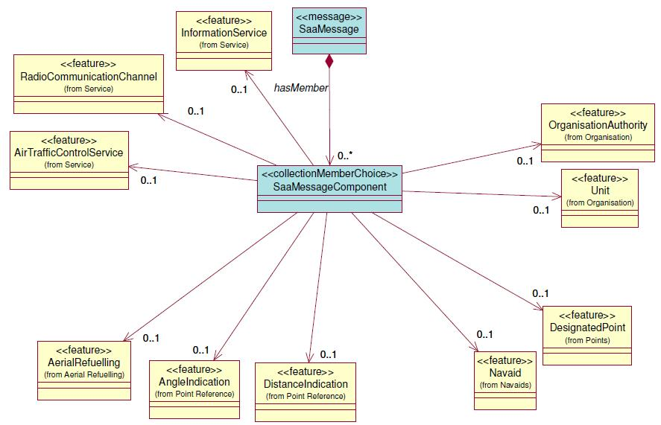
Separate Messages

Slide 6
Service Consumer Experiences
What is more difficult to handle for consumers?
A single service message that can provide many different feature types
3 different service messages to handle different feature types
Have there been difficulties using the AIXM basic message with the Event extension?

Slide 7
Questions
2

Slide 8
Contact Information
Kevin Lew, CNA
kevin.ctr.lew@faa.gov
3

