Slide 1
GNSS and Procedures
AIXM 5.2 Briefing, 1st of July 2020
Presented by: Eduard POROSNICU, EUROCONTROL

Slide 2
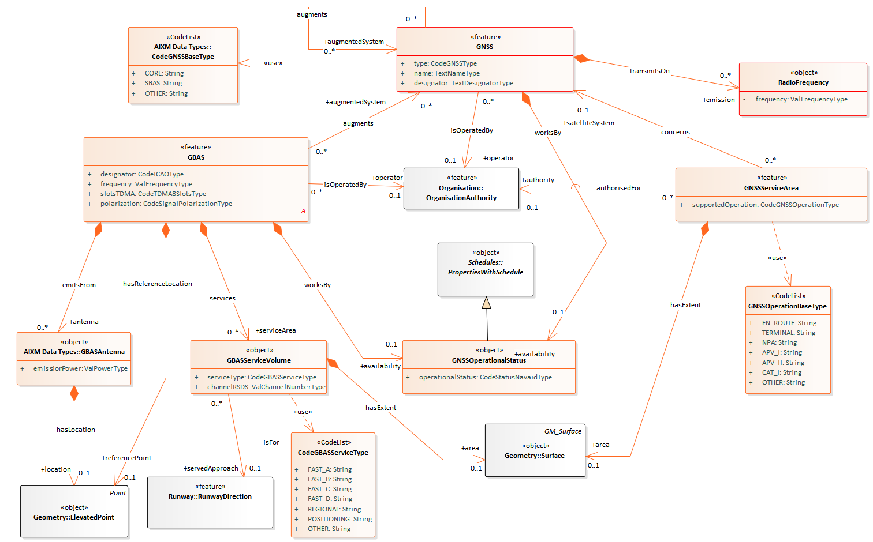
GNSS model (working draft)
Under investigation: integrate GBAS in the Navaid & NavaidEquipment model

Slide 3
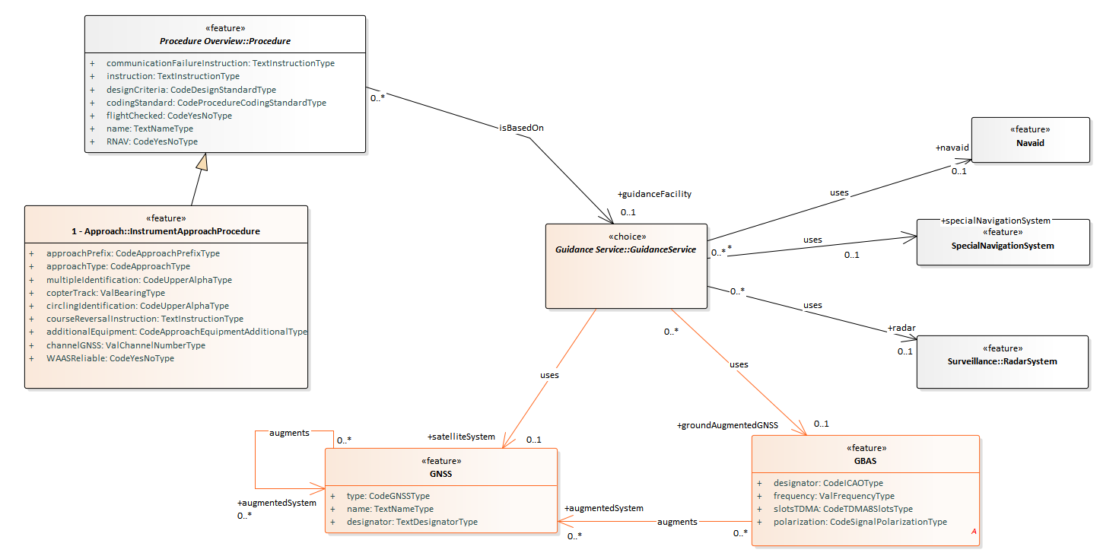
GNSS model (working draft)

Slide 4
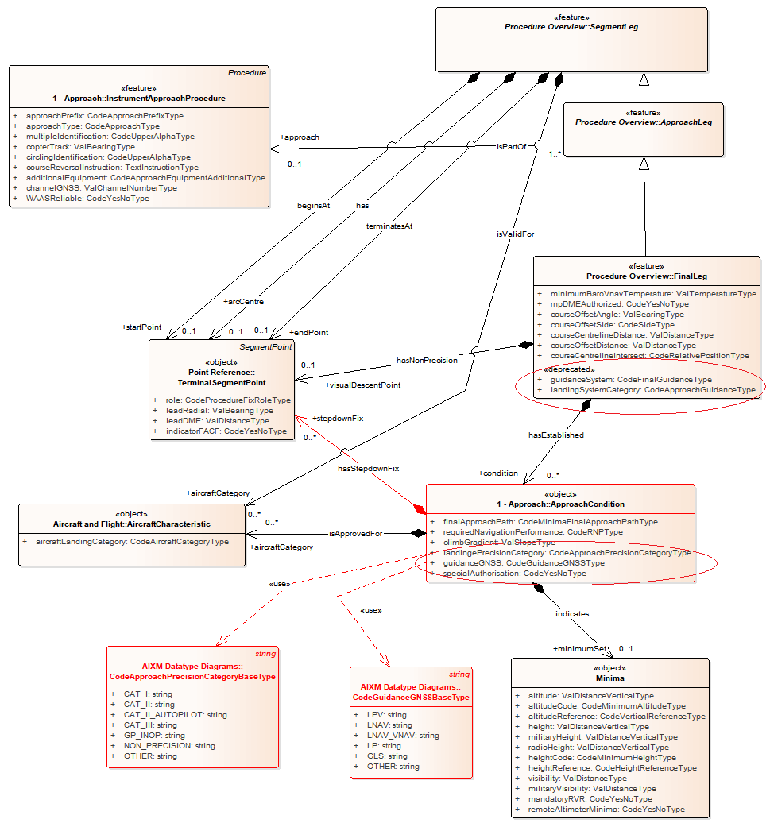
Revision of approach condition (“multiple minima lines”)

Slide 5
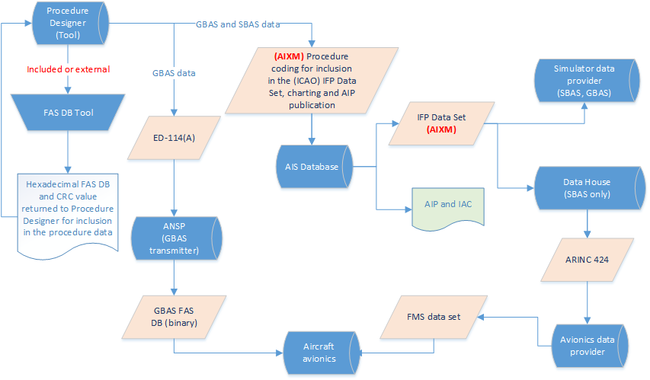
FAS Data Block – Use cases

Slide 6
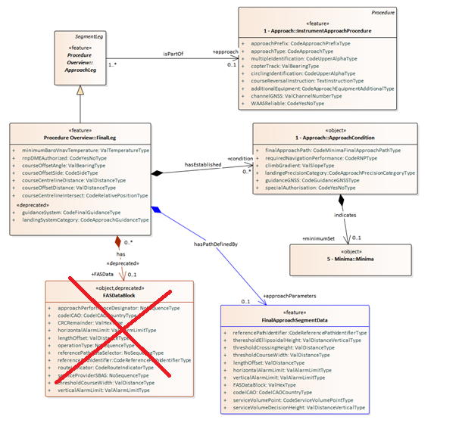
FAS Data Block – model revision

