Slide 1
Angle/Distance indication Under Development
AIXM 5.2 Briefing, 1st of July 2020
Presented by: Katrina Wilson, FAA

Slide 2
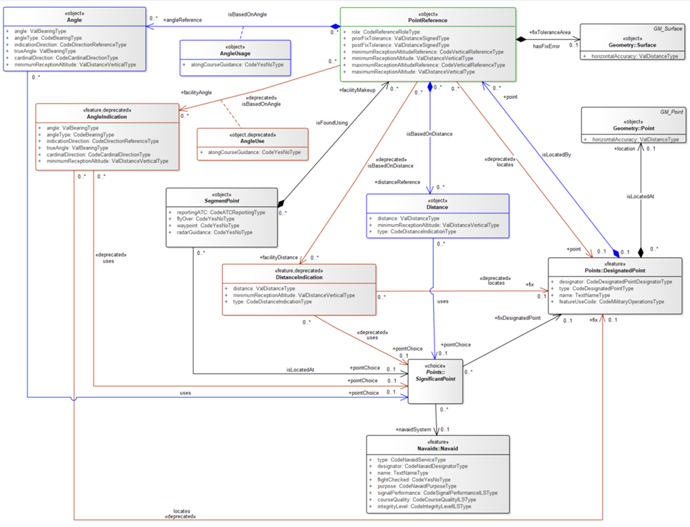
CHANGE AngleIndication and DistanceIndication into objects

Slide 3
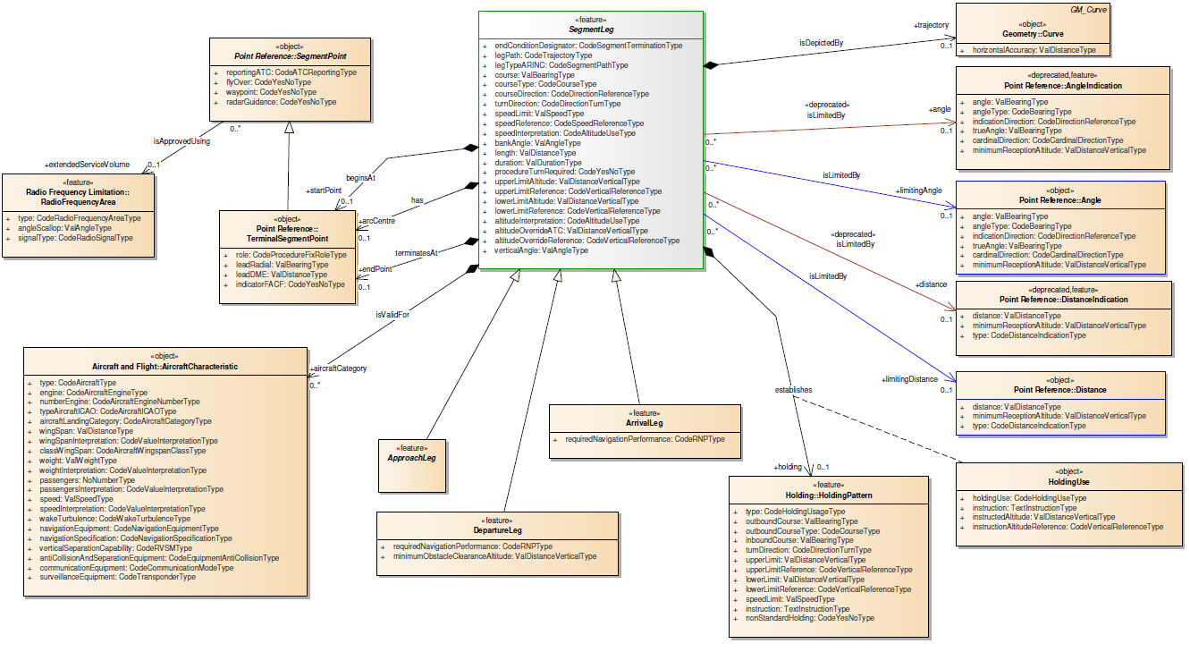
CHANGE AngleIndication and DistanceIndication into objects

