Slide 1
Alignment with PBN concepts
AIXM 5.2 Briefing, 1st of July 2020
Presented by: Razvan GULEAC, EUROCONTROL

Slide 2
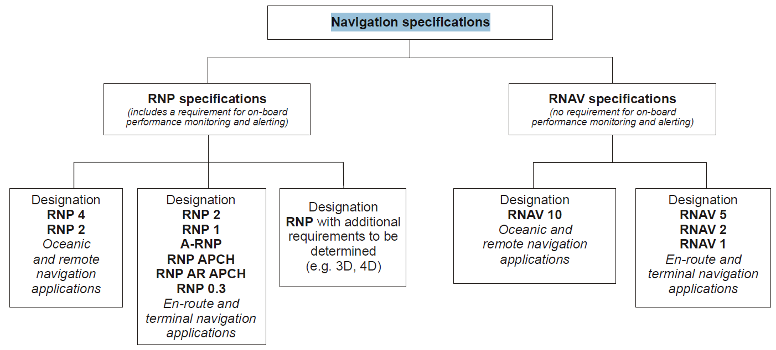
Description & Rationale
Add new:
NavigationRequirements
Remove:
requiredNavigationPerformance
navigationType
navigationSpecification
RNAV
Notes:
With the provision of the ICAO Performance Based Navigation (PBN) Manual – Doc 9613, the area navigation (RNAV) has been redefined and standardised. The new navigation concept is based on three components:
Navigation application
Navigation Specification
Navaid infrastructure
The navigation specification diagram provides a classification of the RNAV and RNP lateral performance requirements for PBN.
The current version of AIXM does not support fully the PBN navigation specification encoding. Therefore, it is proposed to add a new class: NavigationRequirements and to remove the properties: requiredNavigationPerformance, navigationType, navigationSpecification and RNAV

Slide 3
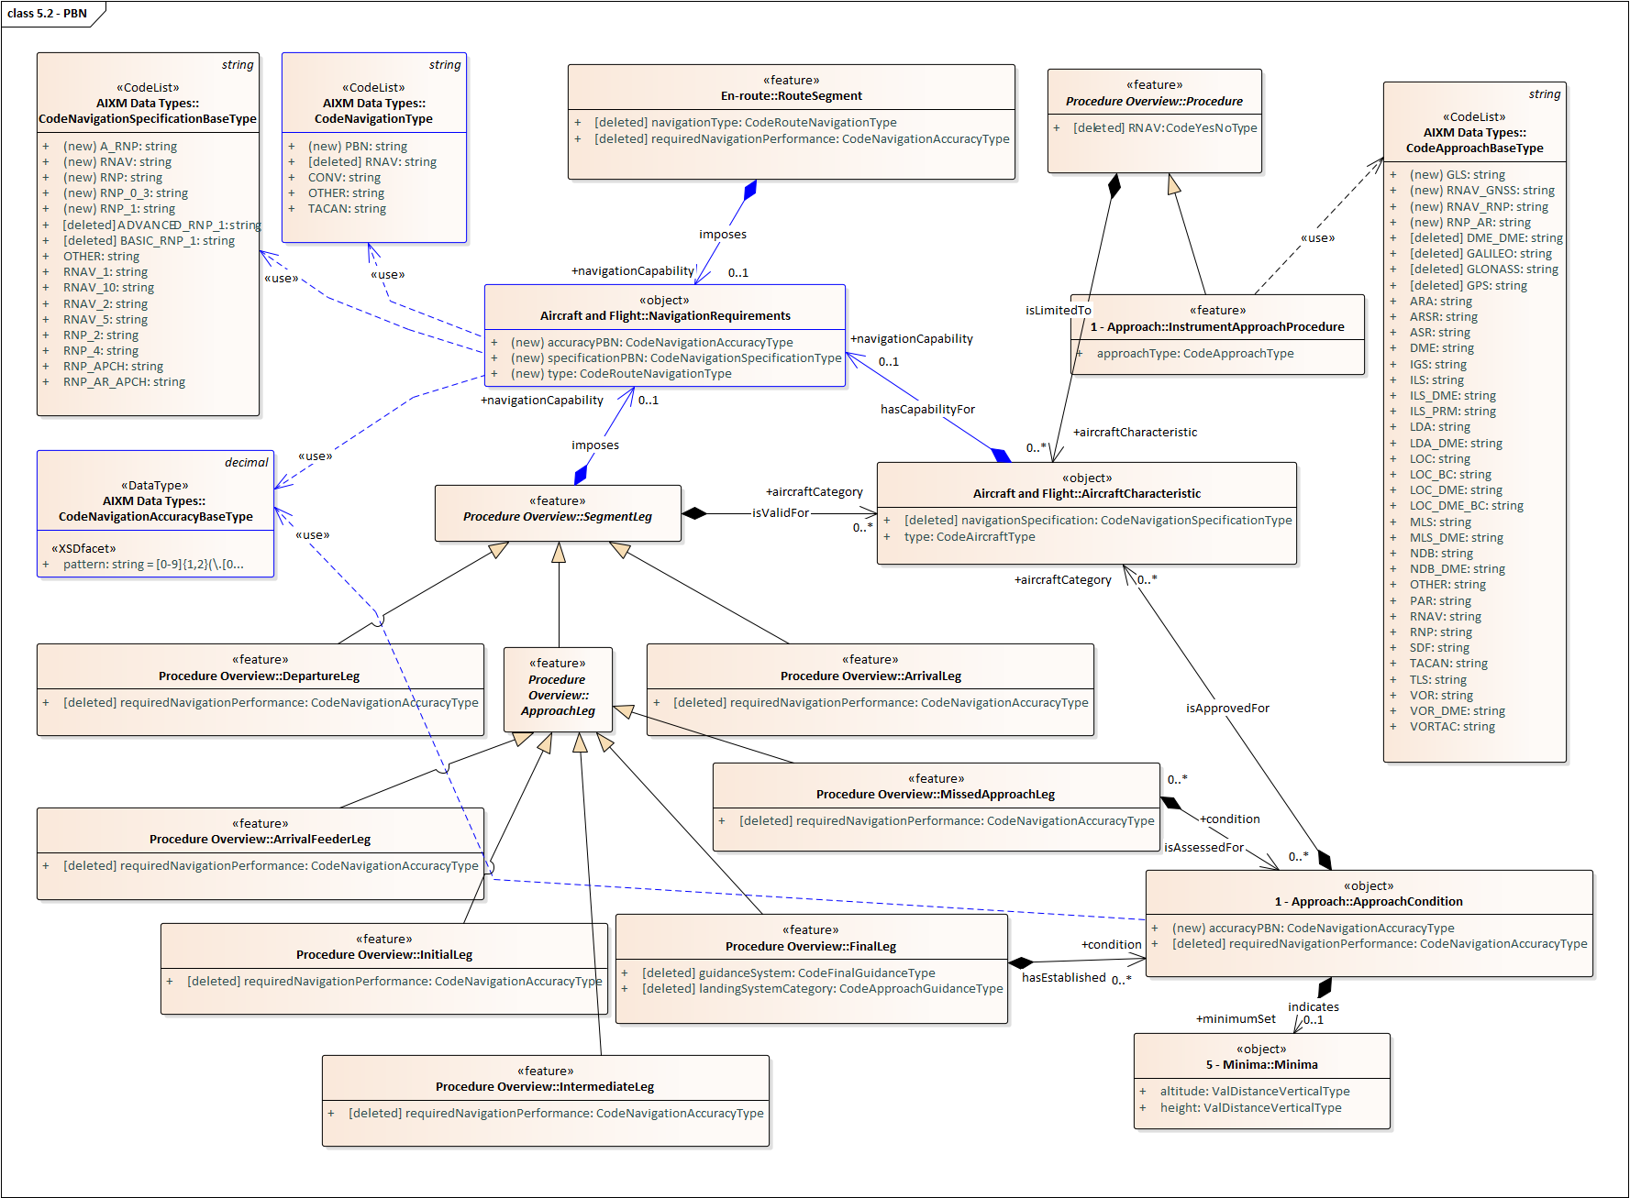
Notes:
The AIXM 5.2 model proposed for the PBN concept is centred on a new class: NavigationRequirements. This class has three simple properties:
accuracyPBN
specificationPBN
type
The corresponding data types are: CodeNavigationAccuracyBaseType, CodeNavigationSpecificationBaseType and CodeNavigationAccuracyBaseType
The new NavigationRequirements class is used by the following classes:
SegmentLeg (abstract class)
RouteSegment
AircraftCharacteristics
Correspondingly, the properties used in AIXM 5.1/5.1.1 for the RNAV/RNP encoding are deleted.

